Slide 1

Student Faculty Relationship App: Emoji Recommendation
Syed Moiz Hassan
Muhammad Fahad
Samia Noor
Supervised By: Sir Saeed Iqbal

Slide 2
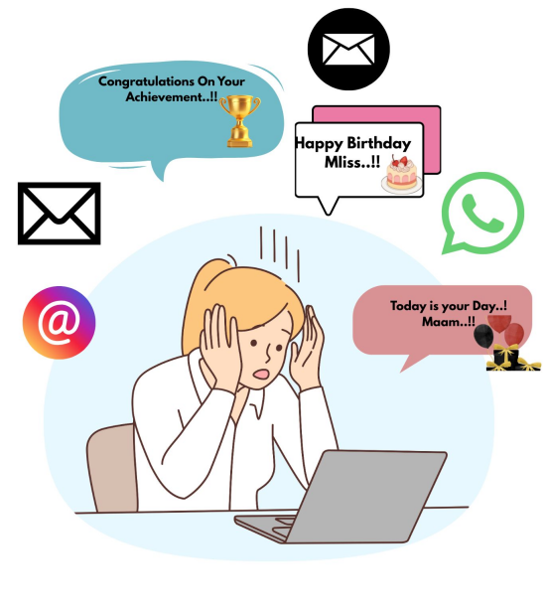
Problem 1:
Excessive volume of messages and notifications about a special event.

Slide 3
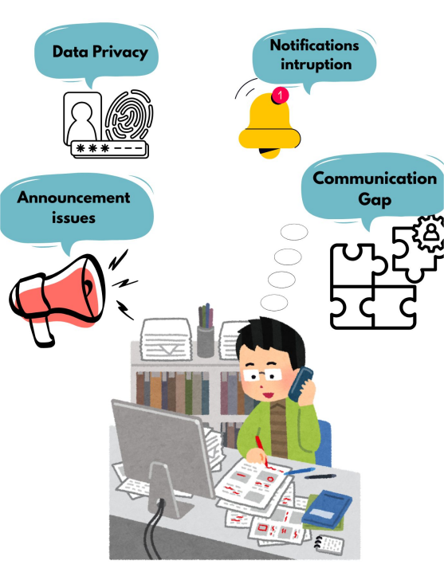
Problem 2:
Teachers face multiple stressors like privacy concerns, Notification interruptions, and information breakdowns.

Slide 4
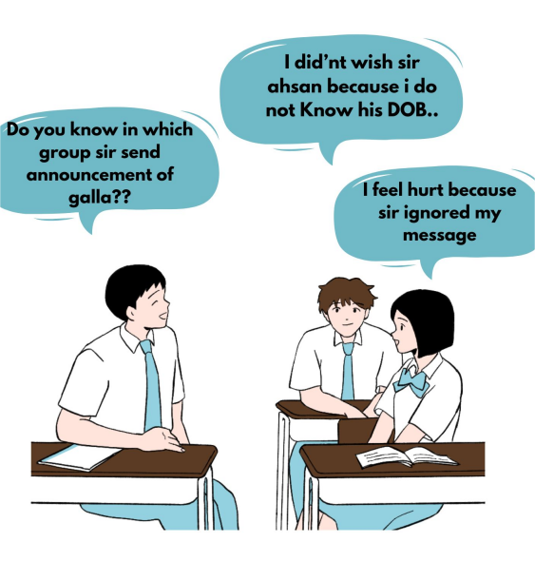
Problem 3:
(Lack of personal data/Information Gap)

Slide 5
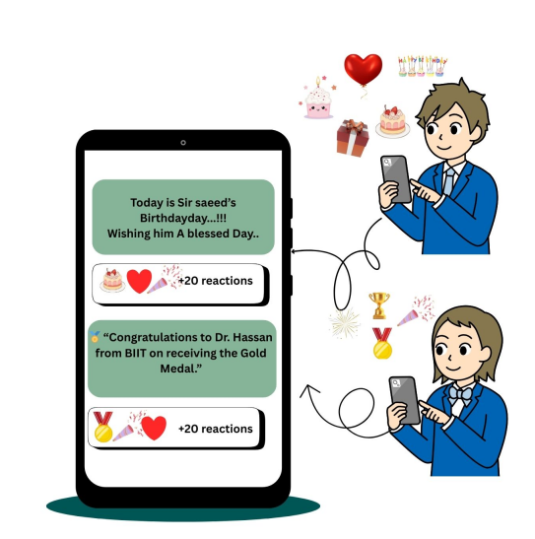
Solution 1:
Wishora,AN Emojis Recommendation App

Slide 6
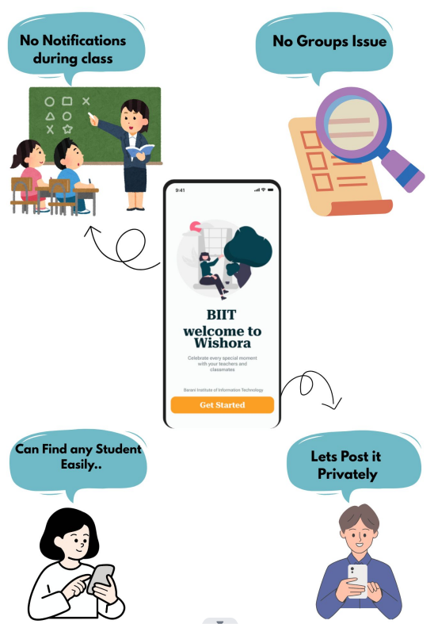
Solution 2:
App providing privacy,different settings, maninaging different things for teacher..

Slide 7
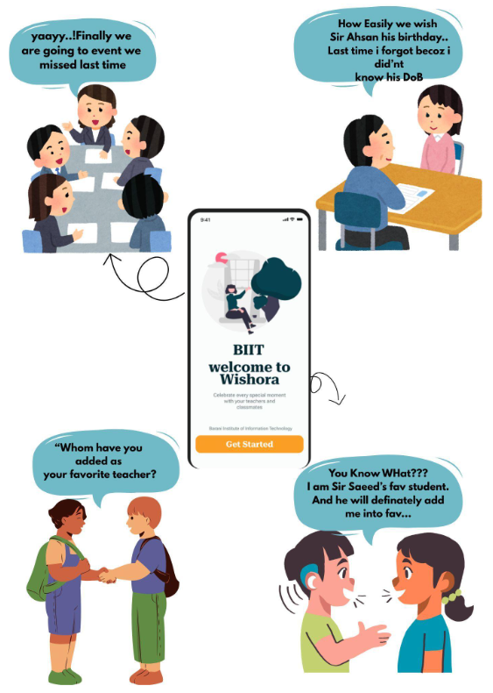
Solution 3:
Wishora,gave students a centralized platform for announcements,event,Birthdays And etc..

Slide 8
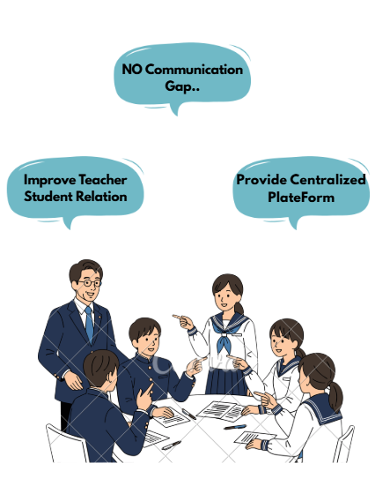
How Solution Works.

Slide 9
THANK YOU

